Slide 1
IRA Rollovers, MyPlanLoan, and Fiduciary Services
Sean Arnold & Rick Schultz
BPAS

Slide 2
Session Overview:
BPAS’ Mission to provide retirement plans that work
Plans that work
  AutoRollovers
  Automatic Enrollment
  Automatic Rebalancing
Fiduciary Services
  Regulatory Environment
  BPAS Fiduciary DC
  BPAS Fiduciary DB

Slide 3
Session Overview:
  IRA$elect
    Rollover solution for employees uncertain of where to rollover
    In partnership with FI or, up to the minimum threshold for FI to service directly.
    Could mean more AUM retention for FI, account retention for BPAS
  MyPlanLoan
    Loan Continuation
    Loan Administration

Slide 4
Plans that work
Higher Participation Rates
Better Employee Investment Decisions
Greatly Improved Employee Retirement Preparedness
EQUALS
A Satisfied Client
Greater Success for BPAS & our Partners

Slide 5
AutoRollovers
Offered as a service to Plan Sponsors
  minimizes number of terminated participants with small balances
  Balances <$5000, generally $200 - $5,000
    May exclude external rollover amounts from determination
Notes:
Benefits Include:
Accelerated access to forfeiture dollars
Elimination of burdensome fiduciary duties
Disclosures and other communications
Benefit Statements, SARs, SPDs, 404(a)(5), QDIA notices, etc…

Slide 6

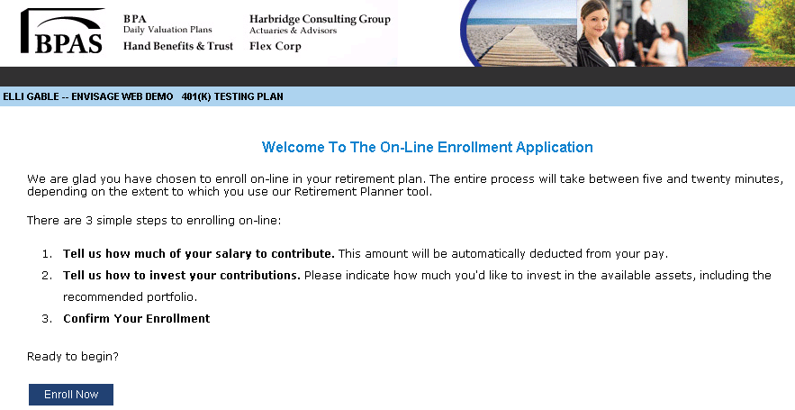
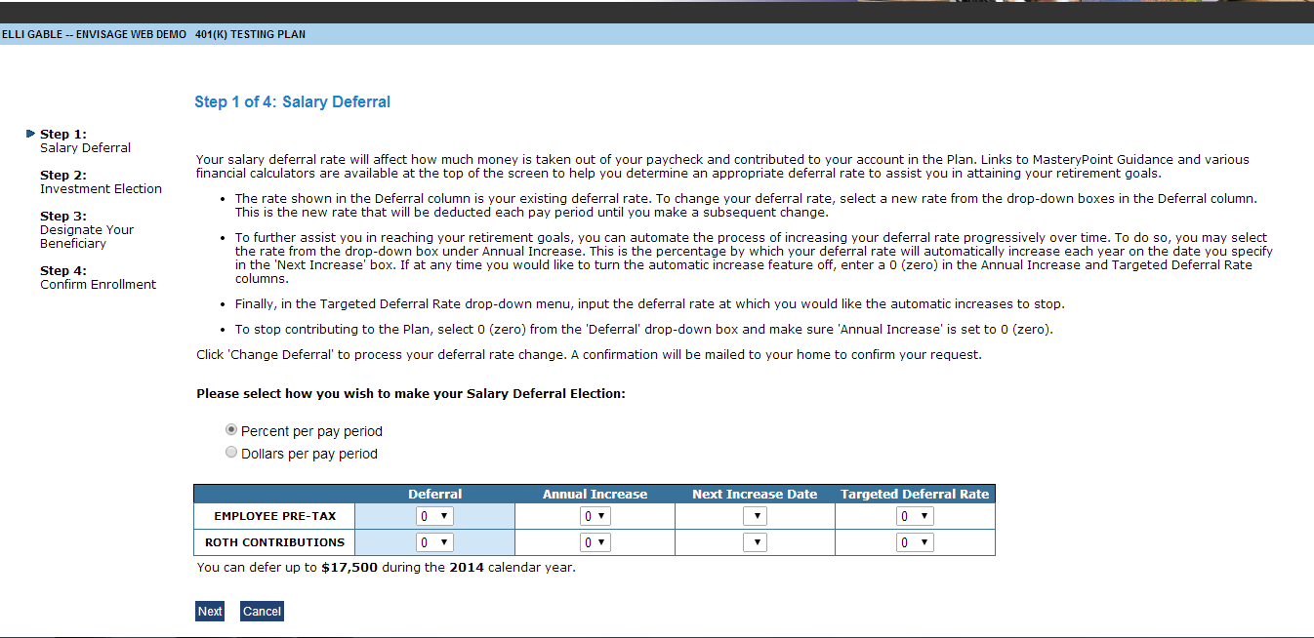
Automatic Enrollment aka: Freedom Savings Plans
Complete the 4-step online enrollment process
Salary Deferral
Investment Election
Beneficiary
Confirm
Notes:
Completely online enrollment process
Participants receive enrollment materials (45 days) prior to their eligibility date
May make an enrollment election via:
www.bpas.com
Automated Voice Response System (VRU)
Works with or without automatic escalation of deferral rates
Benefits of Automatic Enrollment

Slide 7
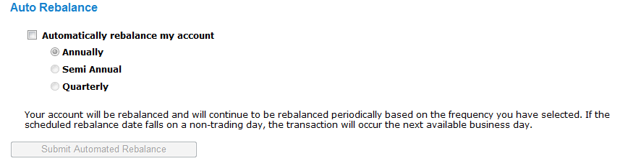
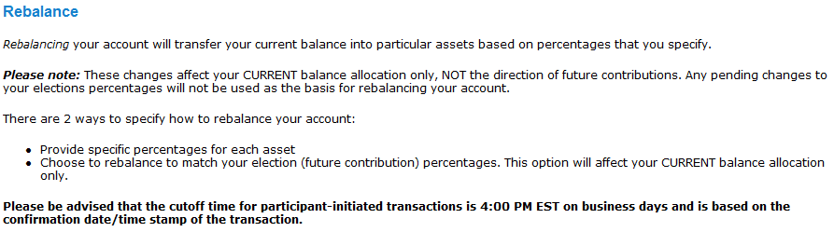
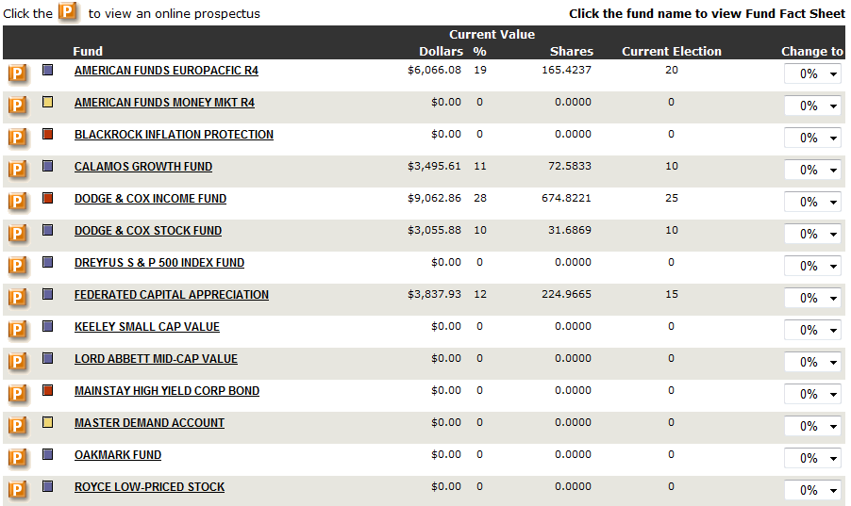

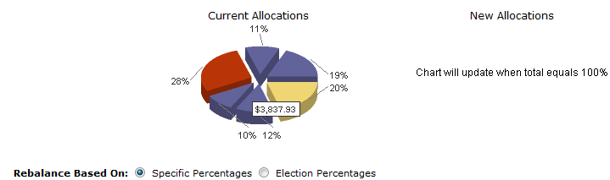
Automatic Rebalancing
Notes:
Allows for the periodic (frequencies?) rebalancing of their investment allocations
Keeps accounts from becoming skewed towards higher performing investments, becoming mis-aligned from their intended asset allocations.

Slide 8
Fiduciary - Regulatory
Environment
Expansion of the definition of fiduciary
  Plan sponsors
    Most don’t understand
    Others want to off-load as much liability as possible
  Financial Intermediaries
    worried about liability
    Limit Reps that can act in an advisory capacity
  IRAs are the next potential target of the DOL
This presents a problem for everyone, but also an opportunity.
  If your organization, whether it be a broker dealer, bank, or an advisory firm, is able and willing to provide ERISA 3(21) or 3(38) Fiduciary Services
  If not, BPAS can assist in providing a solution.

Slide 9
BPAS Fiduciary Services
Goal – Develop products / services to assist our partners
ERISA 3(38) Fiduciary Products
  BPAS Fiduciary DC
  BPAS Fiduciary DB
IRA$elect
Custom Services

Slide 10
Fiduciary DC – Institutional, 25, 50
BPAS Fiduciary Services
  ERISA 3(38) Fiduciary (highest protection for plan sponsor)
  Pre-Selected investment menu
  Investment Policy Statement
  Comprehensive manager search & selection process
  Management of Fund Additions and Deletions
  Qualified Default Investment Alternative – Target Date Funds
  Quarterly investment monitoring report, including quarterly fund commentaries for use by the FI

Slide 11
Fiduciary DC – Institutional, 25, 50
Financial Intermediary
  Relationship manager with the plan sponsor
  Meet with Plan sponsor to review investments, plan activity and benchmarking reports, etc.
  Initial and ongoing participant education
  Compensation Options
    Fee Based (Institutional)
      set needed basis points
    Commission Based
      0.25% or 0.50% 12(b)1
  Sample Agreement

Slide 12
Fiduciary Services
Why use Fiduciary DC
  FI’s Firm does not want the FI selecting funds
  Economies of scale
  Fund changes happen automatically
  FI has more time to service clients and sell more business
  Large advisor uses this product for small plans
Custom Fiduciary Services
  Maintain investment menus for various fund universes
  Provide back office support
  Other
ERISA 3(16) Fiduciary

Slide 13
The Problem
BPAS has been working to devise a mutually beneficial solution to encourage terminated employees to leave accumulated retirement savings invested for the future.
Options:
Leave in the Plan
Rollover into new employer’s plan
Rollover to an IRA

Slide 14
IRA$elect –
BPAS Distribution Activity

Slide 15
IRA$elect –
Rollovers vs. Cash Outs
Dollar Amount
Number of Distributions

Slide 16
IRA$elect – The Solution
Service
Education
IRA$elect
Notes:
Delivery of distribution specific educational content delivered to terminated participants via web and BPAS Customer Service Team
Rollover solution for terminated employees uncertain of where to rollover their assets
Designed to include FI Partners in the retention of accounts (AUM)

Slide 17
IRA$elect - Flexibility
No IRA$elect
All IRA Inquiries redirected to FI Partner
Distribution package letter provides FI Partner contact information.
IRA$elect by BPAS Fiduciary Services
Distribution education/information provided by BPAS Call Center
IRA$elect by Financial Intermediary
IRA Inquiries directed to IRA$elect by FI
Web messaging/link
Distribution Package
Web messaging/link
Distribution Package
Investment related questions directed to BPAS Fiduciary Services Team
FI may choose to offer solution for account balances above a certain threshold

Slide 18
Fiduciary Concerns & Rollovers
Education vs. Advice
Fiduciary Capacity
  Plan-level fiduciary or,
  Participant-level
Compensation Issues

Slide 19
MyPlanLoan
Loan Continuation
  Provides terminated employees with the option to continue repaying on their outstanding plan loans.
  Can be implemented as an ancillary service for plans that wish to retain payroll-deduct repayments for active employees.
Loan Administration
  Eliminates HR/Payroll departments from the loan repayment process.
Notes:
Benefits of Loan Continuation:
Benefits of Loan Administration:

Slide 20
The MyPlanLoan Difference
Sponsor handles much of process
Loan payments are not always applied correctly
Inability for Participant to make additional principal payments
Issues experienced in proper handling of loan defaults
Upon termination of employment, participant must either repay outstanding balance within 90 days or be forced to default
Sponsor “gets out of loan business”
BPAS assumes all aspects of payment processing
Participants can make additional principal payments at any time
BPAS alerts Participants of pending loan default and notifies Custodian
Terminated Participants can opt to continue to pay their loan instead of being forced to default
Traditional Loans Processing
MyPlanLoan Processing

Slide 21
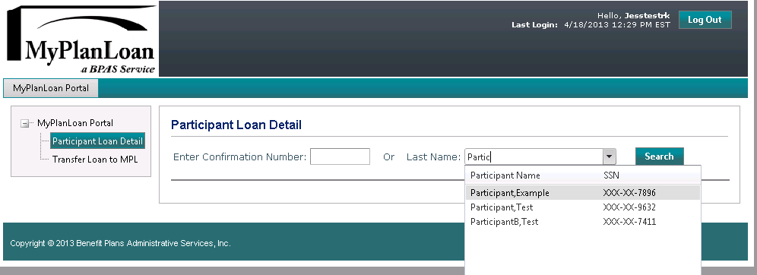
MyPlanLoan a BPAS Service
MPL isn’t just for BPAS plans
MPL Portal available for record keepers and custodians with plans outside of BPAS who wish to use the service
Portal provides link to MPL’s loan administration system
New Loans can be created either manually or through an import

Slide 22
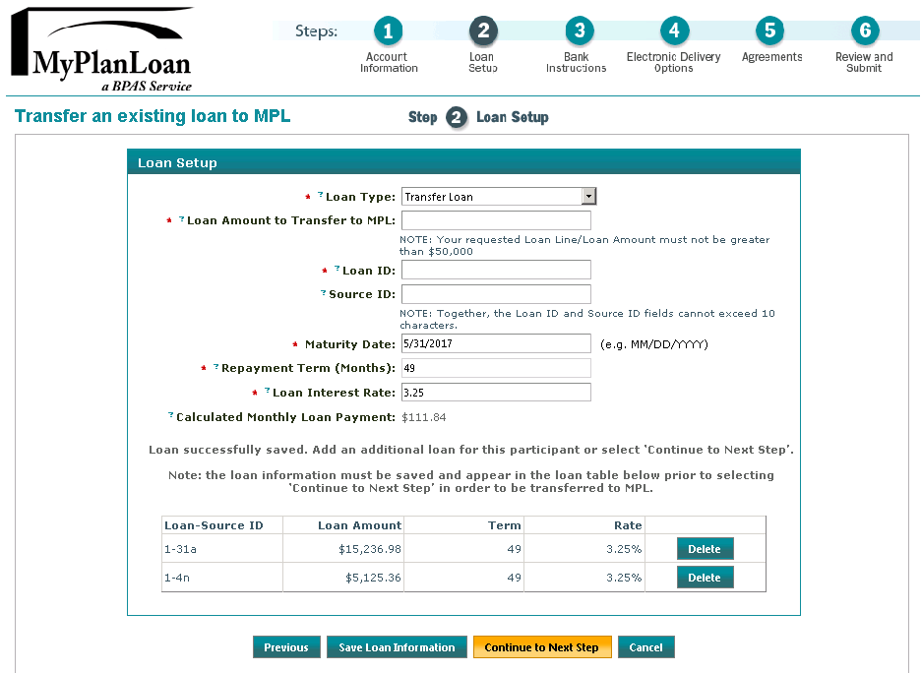
MyPlanLoan Portal
Follow MPL’s wizard to add or transfer a loan (or import a file)
Loans can be added by source, if system needs to track that way

Slide 23
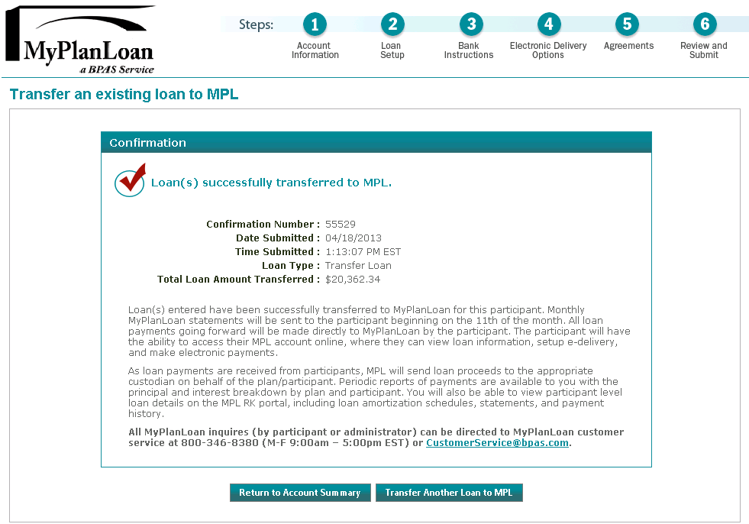
MyPlanLoan Portal
Receive confirmation on web page and via data file
MPL takes over repayment processing from here!

Slide 24
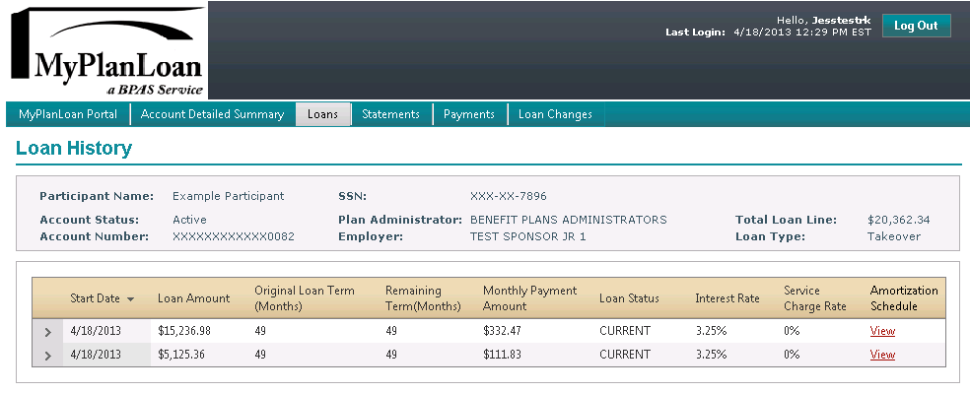
MyPlanLoan Portal
Use the MPL Portal to
  Look up Participant Loan history
  View Amortization Schedules
  View Statements and Payments

Slide 25
MyPlanLoan Case Study
Large National Brokerage firm seeking to improve participant loan compliance for FBO accounts.
  MPL brings ability to track loan payments to amortization schedule
  Provides a means to identify loan failures (missed payments, 72(p) loan.

Slide 26

Fiduciary DB
(including cash balance)
BPAS Fiduciary Services
Custody of plan assets
Payor services
  Benefit payments including 1099’s (check or ACH)
  Pay plan expenses

Slide 27
Fiduciary DB
(including cash balance)
BPAS Fiduciary Services
Investment Management
  ERISA 3(38) Fiduciary
  Develop Asset Allocation
    Input from Plan Sponsor & Actuary
      Plan Sponsor’s risk profile
      Minimum funding requirements
      Pension Expense
      De-Risking
    Plan’s cash flow requirements
      Expected contributions & benefit payments
      Liability Driven Investing (LDI)

Slide 28
Fiduciary DB
(including cash balance)
Investment Management (continued)
  Investment Policy Statement
  Investment Selection
    Primarily low cost index funds
  Quarterly Performance / Monitoring Report
Financial Intermediary
Relationship manager with the plan sponsor
Gather information from the Plan Sponsor and Actuary
Meet with Plan Sponsor to review the investments
Compensation Options
  Fee Based (Institutional)
    Set your basis points
  Commission Based available

Slide 29

Questions?

Slide 30
Contact
Sean Arnold
BPAS
sarnold@bpas.com
Rick Schultz
BPAS
rschultz@bpas.com

