Slide 1


BPAS Technology Update
By Elizabeth Kaido, Sales Relationship Manager

Slide 2
Session Overview
Census gathering application update
MyPlanLoan services update
New Sponsor Reports
Go Green Campaign
Web Enhancements
Mobile App

Slide 3

CPRO Re-write
Census Gathering Application
Application is being reviewed by our Business Analysis team for a complete re-write
Survey of anticipated changes to go out in July
Important for all to respond
Changes will include
  Overall web interface re-design
  Simplified data entry and upload
  More user friendly interaction
  Ease of report access

Slide 4
The MyPlanLoan Difference
Sponsor handles much of process
Loan payments are not always applied correctly
Inability for Participant to make additional principal payments
Issues experienced in proper handling of loan defaults
Upon termination of employment, participant must either repay outstanding balance within 90 days or be forced to default
Sponsor “gets out of loan business”
BPAS assumes all aspects of payment processing
Participants can make additional principal payments at any time
BPAS alerts Participants of pending loan default and notifies Custodian
Terminated Participants can opt to continue to pay their loan instead of being forced to default
Traditional Loans Processing
MyPlanLoan Processing

Slide 5
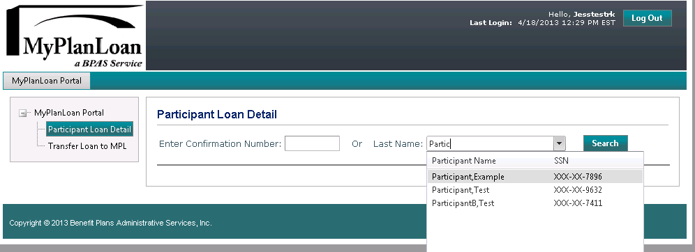
MyPlanLoan a BPAS Service
MPL isn’t just for BPAS plans
MPL Portal available for record keepers and custodians with plans outside of BPAS who wish to use the service
Portal provides link to MPL’s loan administration system
New Loans can be created either manually or through an import

Slide 6
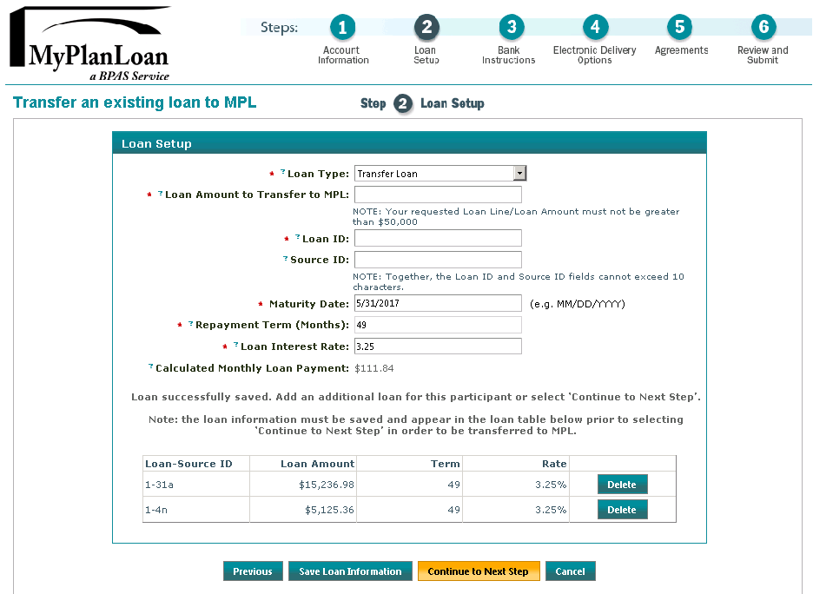
MyPlanLoan Portal
Follow MPL’s wizard to add or transfer a loan (or import a file)
Loans can be added by source, if system needs to track that way

Slide 7
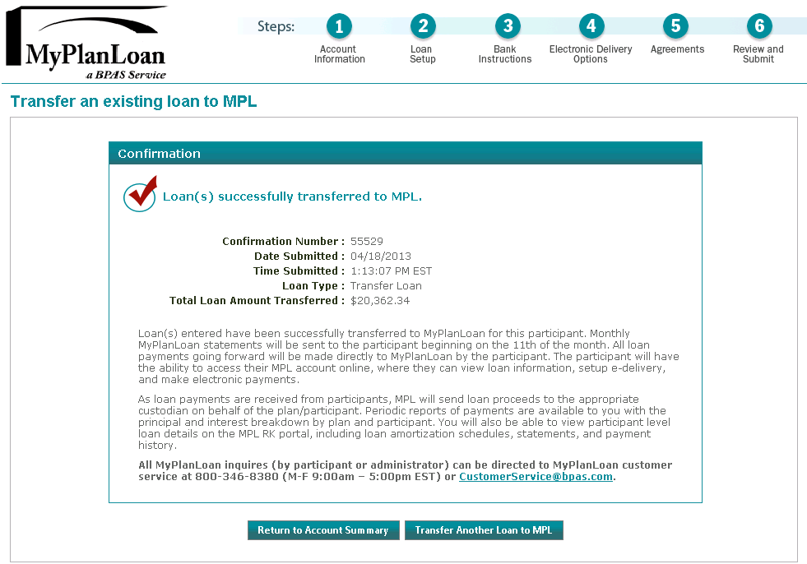
MyPlanLoan Portal
Receive confirmation on web page and via data file
MPL takes over repayment processing from here!

Slide 8
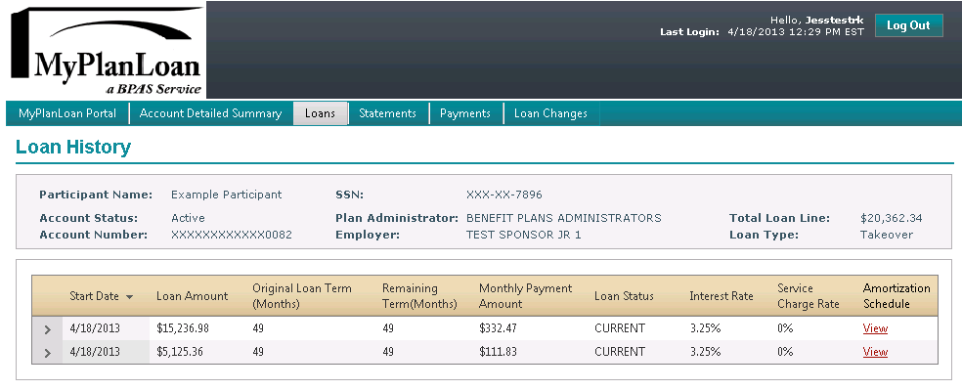
MyPlanLoan Portal
Use the MPL Portal to
  Look up Participant Loan history
  View Amortization Schedules
  View Statements and Payments

Slide 9
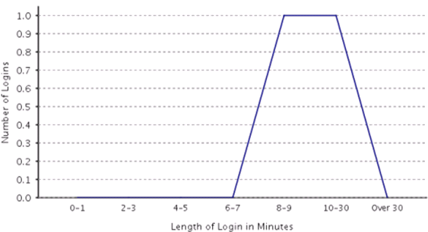
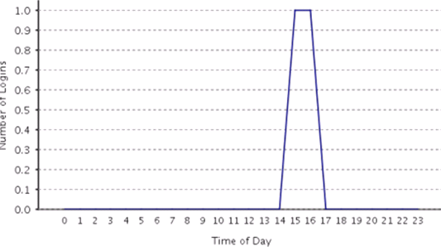
Web Statistics Report
Available by date range
Sponsor can elect to Defer Report
Report is in PDF format
Report Heading includes Plan Name and Date Range
Usage Statistics report includes the following information:
  Number of Total Logins
  represents how many times users logged in
  Number of Unique Logins –
  represents number of individual user log ins
  Number of Logins for Time of Day
  time displayed in military time
  Length of Login Minutes
Notes:
When there is no activity for the period selected the graph will reflect zero activity

Slide 10
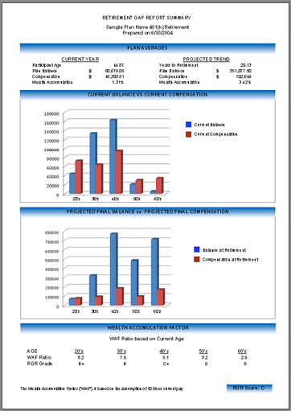
The Retirement Gap Report
Are your participants headed to a secure retirement?
Provides an overall Summary of Current vs Projected
Based around concept of 10 times projected final pay
Current WAF compared to Projected Retirement Age WAF
  Current balance / prior year compensation
  Projected balance / projected compensation
What is it projected to be for each employee at retirement age?
Monitoring trends and progress over time is a key focus of plan sponsors and advisors

Slide 11
BPAS Go Green Campaign
Hard copy delivery per DOL requirements is expensive and carries risk of non-compliance
  Quarterly statements
  Summary Plan Description
  QDIA
  Summary Annual Report
  Safe Harbor Notice
  SMM
  404(a)(5) fee disclosure
  Automatic enrollment related

Slide 12
BPAS Go Green Campaign
Reduction in hard copy delivery requirements reduces plan expenses for all participants, and minimizes client liability over failure to fulfill.
E-delivery is a better mousetrap than 3(16)
DOL requires that participants “opt-in” to electronic delivery
Capturing email information on participants is critical for future targeted messaging.

Slide 13
Participant Elected E-Delivery
Of those participants who logged on to BPAS since June 2013

Slide 14
Participant ACH Data Capture
Schedule for rollout
  Distribution Requests – Summer 2014
  Loan Issue Requests - Fall 2014
  IRA Contributions – Last quarter 2014

Slide 15
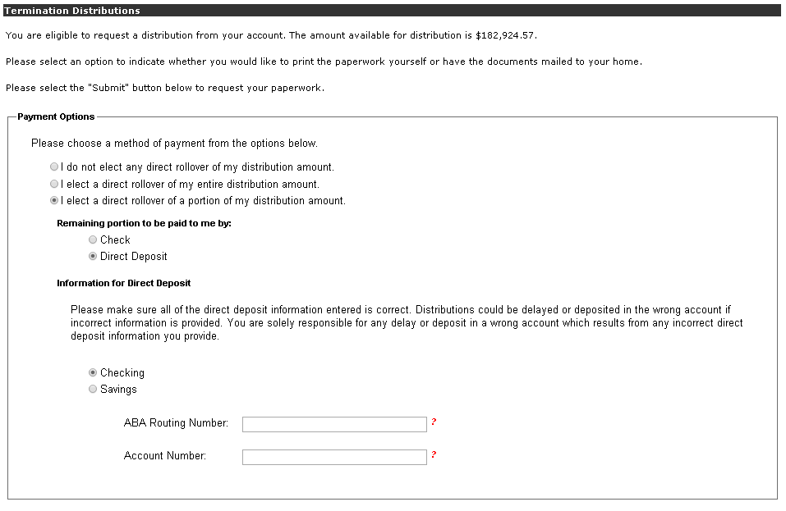
Participant ACH Data Capture
Allows participants to select ACH as a payment option
Participant will enter bank routing number and account number prior to requesting distribution paperwork
Entry is fed electronically to recordkeeping system and is included in distribution process
ACH is processed on T+1

Slide 16
Web/ Email Targeted Messaging
Participant specific messaging
  Catch-up eligibility
  Where am I relative to my savings goals?
    Saving milestones
      “Congratulations, your account has now reached 2 times annual pay!”
    Encourage saving
      “Did you know that you can earn more match if you increase your deferral rate?”
  IRA rollover planning
  Expiration of hardship suspension
  Missing beneficiary information
Notes:
New look and feel of website for q2 2015, includes
Targeted messaging
more personalized info on future savings,
Thermometer showing where you are in relation to the amount you have saved
Giving pa tools how well are they doing toward their goal before it’s too late
How successful are they
Beneficiary designation (absence of) - TALKING POINT
Mobile app will require email to access - TALKING POINT
Still in planning and discussion stages
Home page being re-designed to provide participant specific messaging

Slide 17
Web Cash Balance
Envisage development of participant and sponsor web sites for cash balance plans administered on ASC Valuation System
  Participant Home Page with Balance
  Document warehouse
    On-line Beneficiary
    Required notices
    Participant statements (archived)
    Participant education
    Valuation, PBGC, 5500 forms and reports

Slide 18
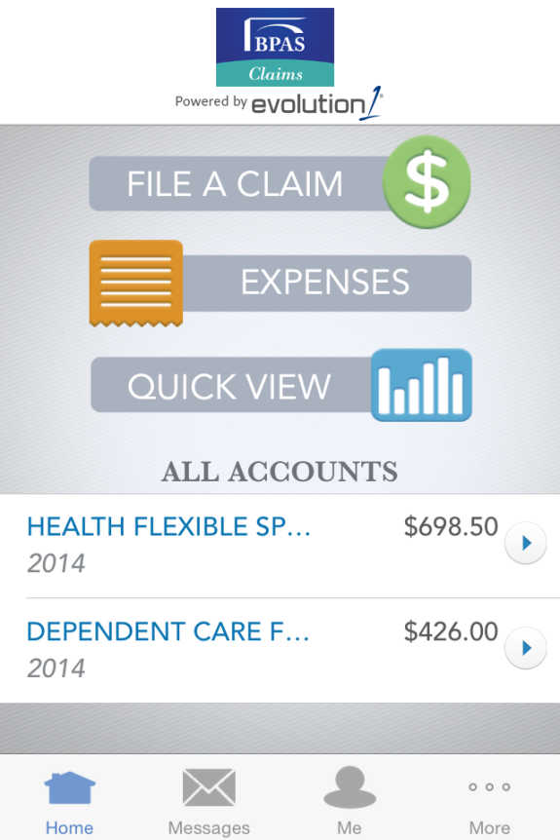
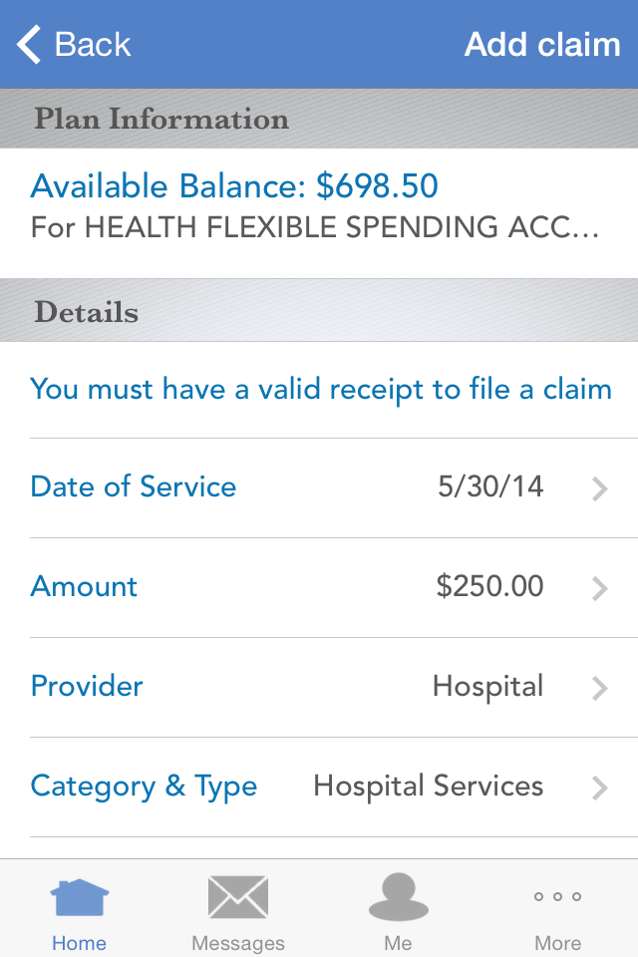
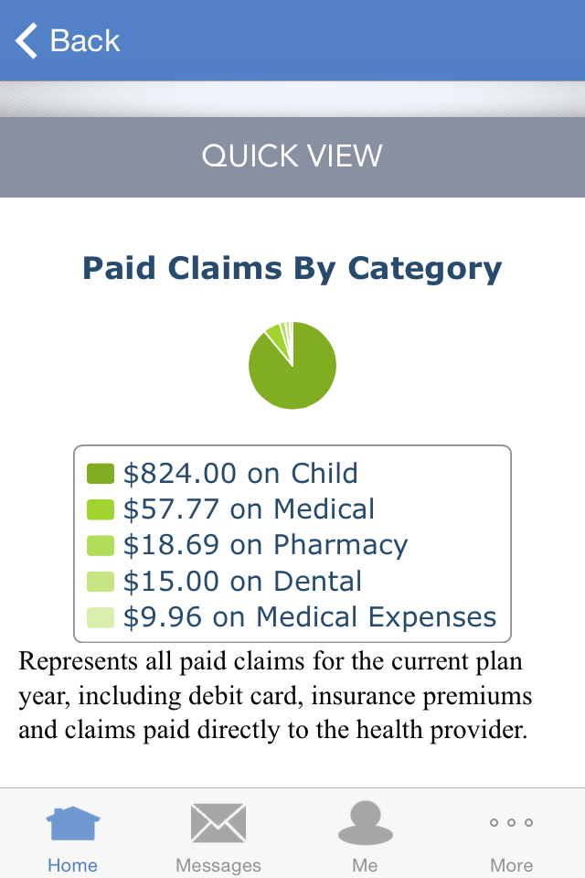
BPAS Mobile Apps
BPAS Flex App currently available
Check account balance
Review paid claims
Claim reimbursement made simple
  Take a picture of your receipt with your smartphone and upload

Slide 19
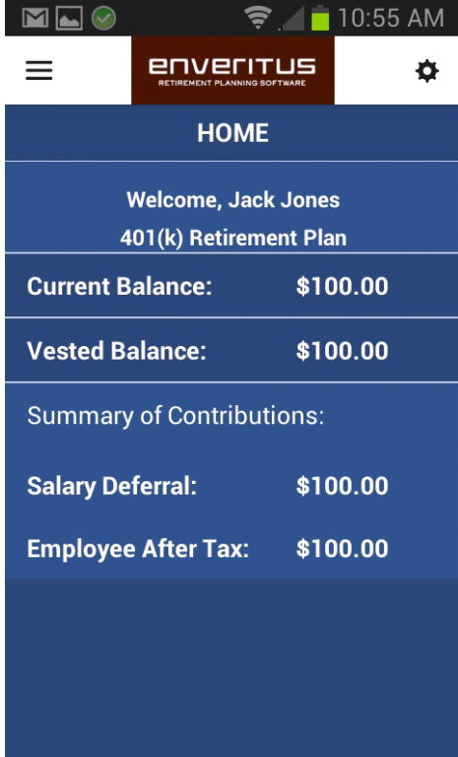
BPAS Mobile Apps
COMING SOON
BPAS Mobile App for Participant Website
Sneak Peak

Slide 20
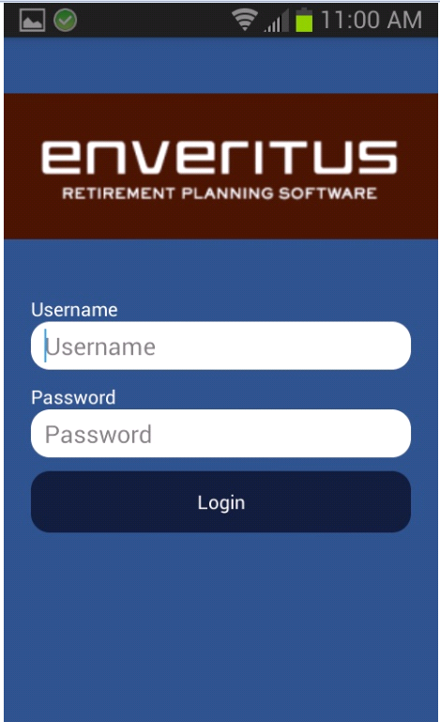
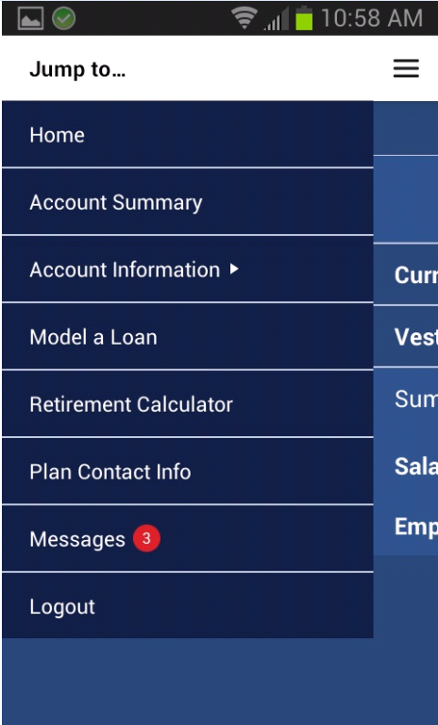
LOGIN HOME MENU

Slide 21
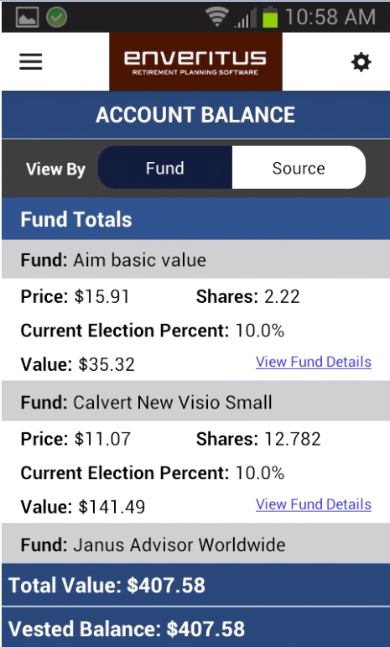
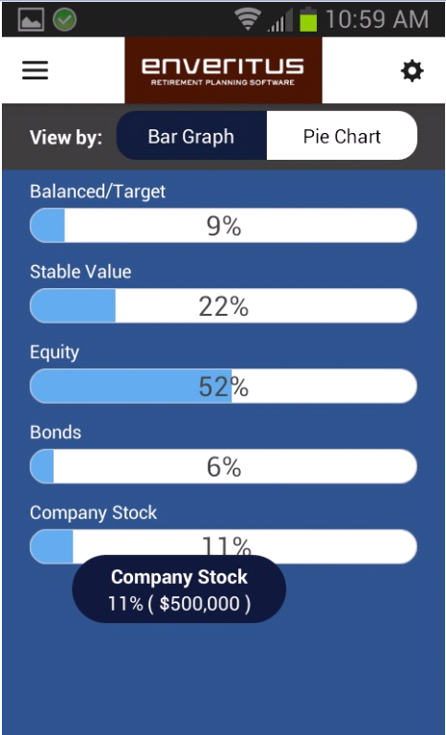
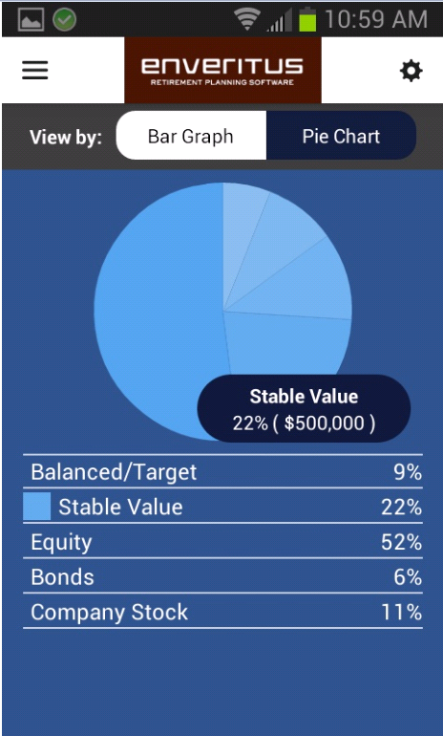
Account Summary Account Information

Slide 22
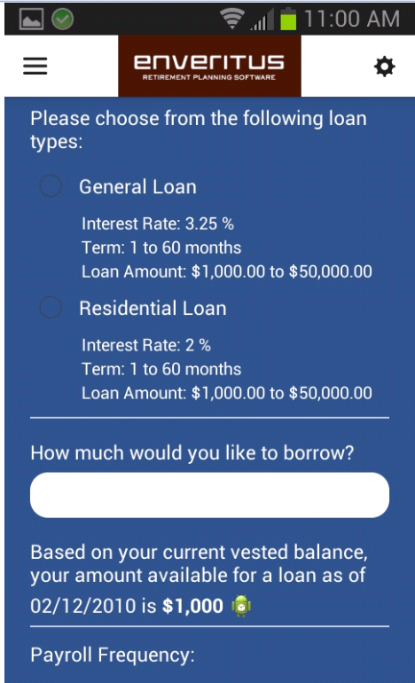
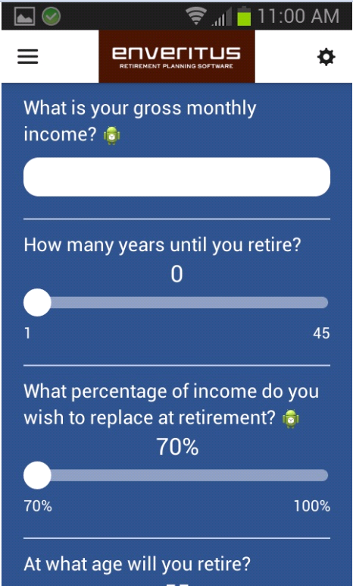
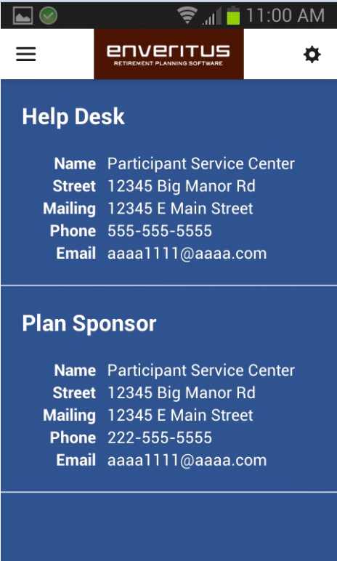
LOAN MODELING RETIREMENT CALCULATOR PLAN CONTACTS

Slide 23

Questions?

Slide 24
Contact
Debra Lekki
Senior Business Analyst
BPAS
dlekki@bpas.com

