Slide 1
Challenges for DC Plan Sponsors
Maryann K. Geary

Slide 2
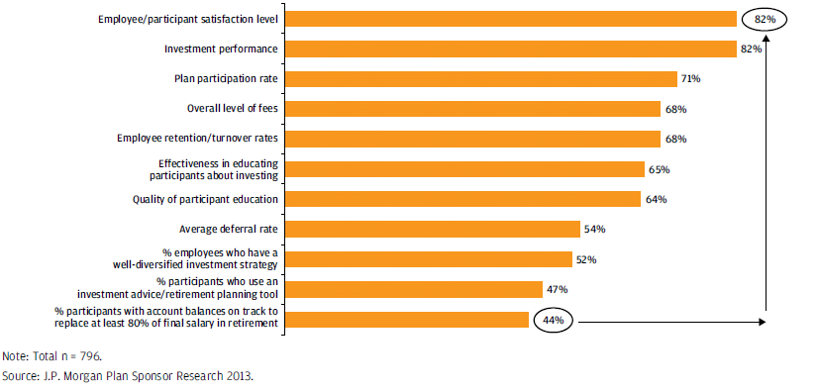
What Drives Participant Satisfaction?

Slide 3
Redefine Success
I would like to have more people aware of {their} contribution levels and what it takes to retire at the correct age
DC plans are the primary retirement vehicle
Participants are still not saving enough
  Aging workforce
  Employees preoccupied with financial worries
Plan sponsors hesitant about automatic enrollment
  More than 60% of participants in favor of or neutral to features
  Once enrolled in automatic enrollment plan, less than 10% opt out

Slide 4
Inertia
“ we would have offered [fewer] core choices to streamline the plan and avoid confusion
Automatic enrollment without escalation may stall participant savings
Participants feel overwhelmed; make poor investment decisions
  Make initial investment decision and never change it
  In plan re-enrollment, participants are notified that existing assets and future contributions will be invested in the plan’s QDIA on a certain date unless they make new elections

Slide 5
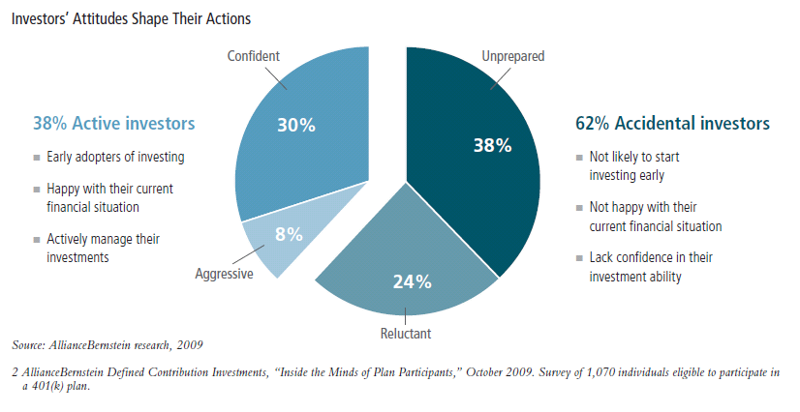
Participant Investment Behavior
“Participants like to try invest ng on their own, but most don’t have the time or know-how to do it well.”

Slide 6
Fiduciary Liability
“I need to spend more time with the plan, but it’s difficult to find the time when running the business
Plan sponsors responsible for prudent management of the plan
“Prudent Expert” rule:
  Behavioral studies related to participant saving habits
  Impact of investment structure on fees
  Monitoring effectiveness of the plan’s default fund

Slide 7

Communication
“I know that I and others in the decision-making process are not aware of how it all works together
Traditionally, plan sponsors have used communication as a promotional tool to help employees understand and appreciate benefits
Not used to promote an understanding of what participants are on track to receive at retirement
Personalizing communication
  Target messaging
  Gap analysis

Slide 8

Administrative Burdens
Retirement plans are subject to many, often confusing, laws and regulations
“There are so many compliance issues! I need more help so things are caught before they’re done, not afterward.”

Slide 9
Top 10 Compliance Failures
1
Eligible compensation improperly included or excluded from contribution calculations
2
Exclusion of eligible participants
3
Inclusion of ineligible participant
4
Distribution failures
Incorrect distribution amounts/improper forfeitures
Distribution to ineligible participant
Incorrect vesting

Slide 10
Top 10 Compliance Failures
5
Deferral failures
6
Plan Document failures
7
Failure to follow the Plan’s matching contribution provisions
8
Failure to satisfy the ADP/ACP nondiscrimination tests

Slide 11
Top 10 Compliance Failures
9
Improper hardship withdrawals
10
Issues with participant loans

Slide 12
When Errors do Occur?

Slide 13
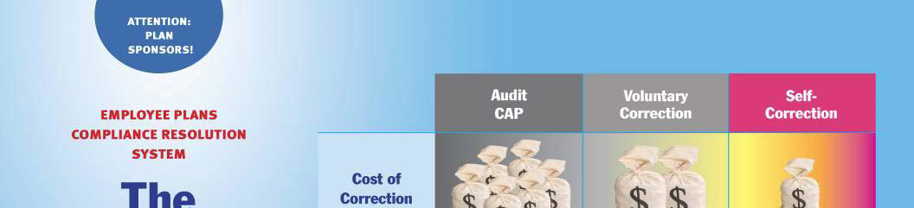
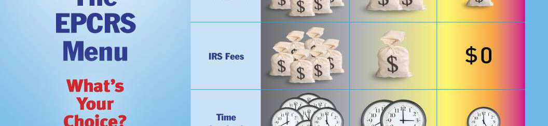


Slide 14

Correction Principles
The EPCRS common “principles” for plan correction:
  Must correct for all years (not just those “open” to audit)
  Correction method must be reasonable, appropriate, and consistently applied
  Correction must restore the plan to position in which it would have been had the error not occurred
    Includes, most importantly, restoring earnings

Slide 15
Types of Error under EPCRS
Operational Errors
Failure to follow the plan’s terms
Document Errors:
Either did not do a required amendment or added disqualifying language to the plan
Demographic Errors
The plan operated as it was supposed to, but the coverage or nondiscrimination tests were failed because of changed demographics
Employer /Sponsor Error
A company that was not eligible to sponsor this kind of plan nonetheless adopted it (e.g. 403(b), 457 plans)

Slide 16

Self Correction Program (SCP)
“Do It Yourself” procedure
Correction of insignificant errors at any time
  Limited time period for correction of significant errors

Slide 17
What is an Insignificant Failure?
Based on facts and circumstances
Number of failures that occurred
Percentage of plan assets involved
Number of years in which the error occurred
Reason for the failure
Number of participants affected

Slide 18

What is a Significant Failure?
Anything not insignificant
Limited Time Period
  Last day of 2nd plan year following year of occurrence
  ADP/ACP – last day of 3rd plan year following year for which testing failed

Slide 19
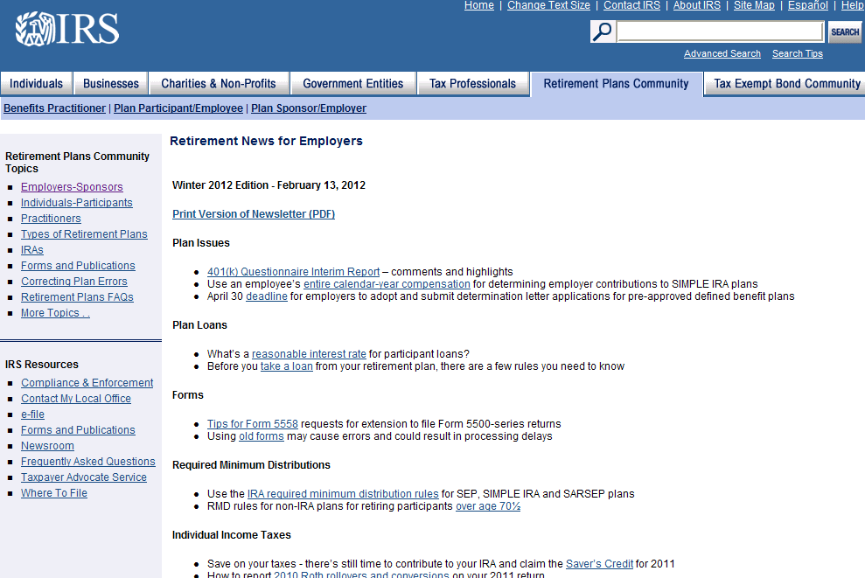
Where to Get More Information
Visit Irs.gov

Slide 20
DOL Programs

Slide 21

DOL Programs
Delinquent Filers Voluntary Correction Program (DFVCP) – for late filed 5500s
Voluntary Fiduciary Correction Program (VFCP)

Slide 22
DOL Penalties
Late Filers
$50/day with no limit
Non-filers
$300/day or $30,000/ye
Failure to include audit
$150/day up to $50,000
Failure to include schedule of assets
$100/day up to $36,500

Slide 23

Relief for Late Filings
Even with the best intentions, plan sponsors occasionally miss deadlines. Relief can be obtained with:
Reasonable Cause Letters
DFVCP

Slide 24
Delinquent Filer
Voluntary Compliance Program
Available from the DOL
Penalty reduced to $10 per day
Per plan cap – multiple filings
Avoids IRS and DOL full penalties
1
2
3
4

Slide 25

Penalty Structure
The DOL provides an interactive calculator that facilitates accurate computation of the penalty
A $10 per day penalty is applied to each delinquent filing
  Penalty cap for small plan is limited to $750
  Penalty cap for large plan is limited to $2,000
    Per plan cap limits the penalty to $1,500 for small plan and $4,000 for a large plan regardless of the number of late annual reports filed for the plan

Slide 26
DFVC Penalty Calculator
The DOL provides two web-based tools to assist in correcting late filing of Form 5500 under the DFVC program:
  Online penalty calculator that a practitioner may use to calculate the penalty
  An online tool for filing the application and paying the penalty: www.dol.gov/ebsa/calcualtor/dfvcpmain.html
The DOL reported that many DFVC applications contain calculation errors which result in additional time and correspondence

Slide 27
Online
Calculator

Slide 28

DFVCP and IRS
IRS says if you participate in DFVCP, they will automatically waive IRS penalties
If the IRS sends a penalty letter:
  Amend return and indicate you are filing under DFVCP
  File under DFVCP
  Inform IRS you have filed under DFVCP
  It works!

Slide 29
VFCP
Established by the Department of Labor
Allows affected individuals to voluntarily correct certain fiduciary violations
  Individuals must submit application to the DOL with all the required documentation for review and approval
  If approved, individuals can avoid certain civil ERISA penalties
Includes 19 specific transactions

Slide 30
19 Transactions
Delinquent Participant Contributions and Participant Loan Repayments
Delinquent Participant Contributions to Insured Welfare Plans
Delinquent Participant Contributions to Welfare Plan Trusts
Fair Market Interest Rate Loans to Parties in Interest
Below Market Interest Rate Loans to Parties in Interest
Below Market Interest Rate Loans to Non-Parties in Interest
Below Market Interest Rate Loans Due to Delay in Perfecting Security Interest
Participant Loans Failing to Comply with Plan Provisions for Amount, Duration, or Level Amortization

Slide 31
Transactions
Defaulted Participant Loans
Purchase of Assets by Plans from Parties in Interest
Sale of Assets by Plans to Parties in Interest
Sale and Leaseback of Property to Sponsoring Employers
Purchase of Assets from Non-Parties in Interest at More Than Fair Market Value
Sale of Assets to Non-Parties in Interest at Less Than Fair Market Value
Holding of an Illiquid Asset Previously Purchased by Plan
Benefit Payments Based on Improper Valuation of Plan Assets
Payment of Duplicate, Excessive, or Unnecessary Compensation
Improper Payment of Expenses by Plan
Payment of Dual Compensation to Plan Fiduciaries

Slide 32
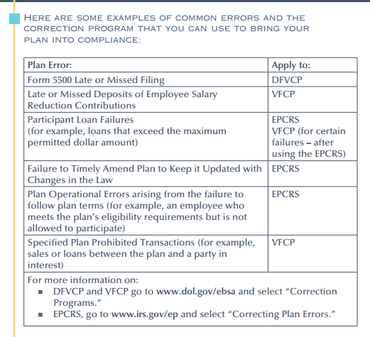
Common Errors

Slide 33
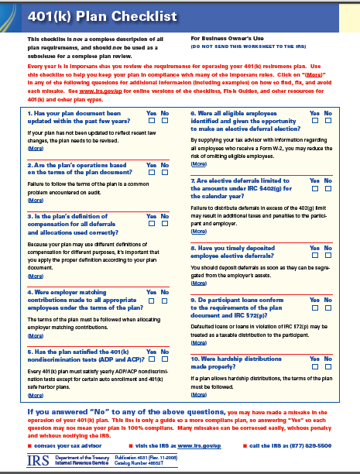

Slide 34

Questions?

Slide 35
Contact
            Maryann Geary
            BPAS
            3501 Masons Mill Road, Suite 601
            Huntingdon Valley, PA 19006
            267-948-1623
            Mgeary@bpas.com

