Slide 1
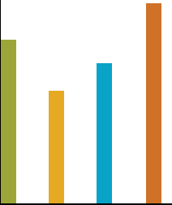
Benchmarking v2.0:
Improved Outcomes for Plan Sponsors and Participants
Tom Kmak, CEO
Fiduciary Benchmarks

Slide 2
Agenda
FBi Benchmarking Basics
Benefits to Plan Sponsors
Benefits to Participants
Notes:
1

Slide 3

What are the duties of a Fiduciary?
Fiduciaries have important responsibilities and are subject to standards of conduct because they act on behalf of participants in a retirement plan and their beneficiaries. These responsibilities include:
  Acting solely in the interest of plan participants and their beneficiaries and with the exclusive purpose of providing benefits to them;
  Carrying out their duties prudently;
  Following the plan documents (unless inconsistent with ERISA);
  Diversifying plan investments; and
  Paying only reasonable plan expenses.
Source: www.dol.gov/ebsa/publications/fiduciaryresponsibility.html
Notes:
2

Slide 4

What does the DOL say about 401(k) Fees?
“When you consider the fees in your 401(k) plan and their impact on your retirement income, remember that all services have costs. If your employer has selected a bundled program of services and investments, compare all services received with the total cost. Remember, too, that higher investment management fees do not necessarily mean better performance. Nor is cheaper necessarily better. Compare the net returns relative to the risks among available investment options. And, finally, don’t consider fees in a vacuum. They are only one part of the bigger picture including investment risk and returns and the extent and quality of services provider.”
Source: A Look at 401(k) Plan Fees, U.S. Department of Labor, October 2010
Notes:
3

Slide 5


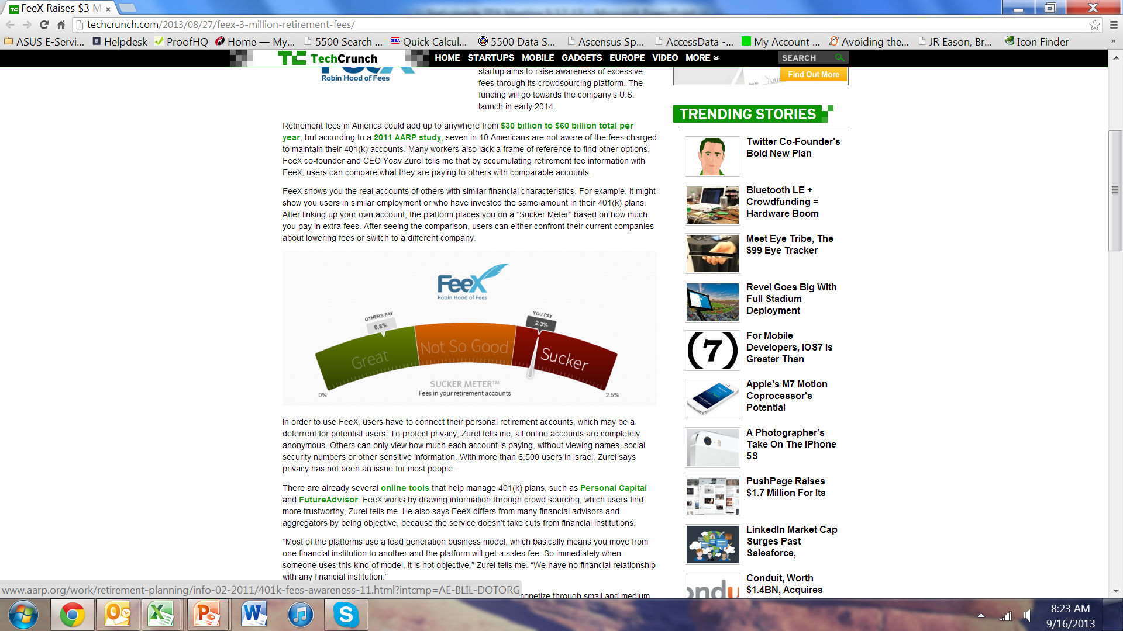
True or False:
Low Fees is the Fiduciary Standard
“That’s the trouble with the world today, nobody takes the time to do a really sinister interrogation anymore”

Slide 6
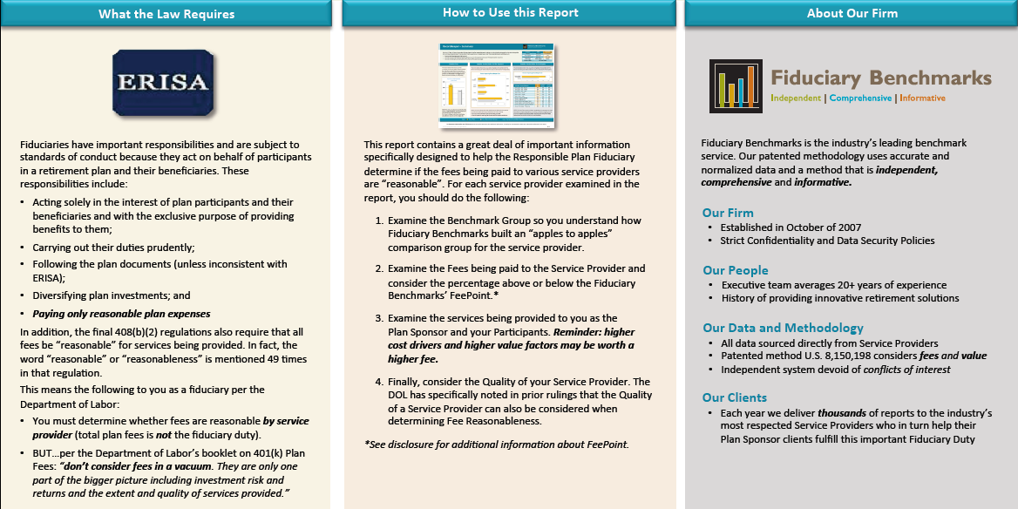
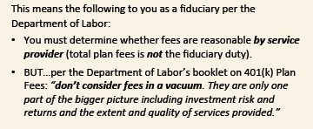
v2 Improvement:
Additional Guidance for the Fiduciary

Slide 7
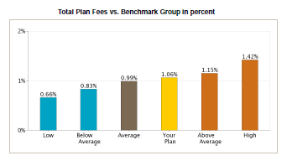
True or False:
Reasonable Total Plan Fees is the Fiduciary Issue
Notes:
6

Slide 8
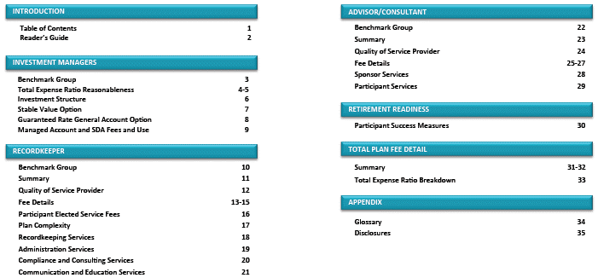
v2 Improvement:
Distinct Benchmarking by Service Provider
Notes:
7

Slide 9
Agenda
FBi Benchmarking Basics
Benefits to Plan Sponsors
Benefits to Participants
Notes:
8

Slide 10


Documenting the Process for Fiduciaries
The impact per one prominent ERISA attorney:
  Know what your fees are
  Compare them to benchmarks
  Monitor on an ongoing basis
  Make sure you have real documentation
  Hire Third-Parties for an independent review
  Make sure you conduct a fiduciary audit
  Have a Fiduciary Manual
$16.5 million
Marcia Wagner, Plan Sponsor interview, December 2009
“The lesson is to benchmark your plan’s services against appropriate peer-group data. It would be difficult for a plaintiff’s attorney to show that you were imprudent if you take that step and if the results are reasonable.”
  Fred Reish, Drinker Biddle, Plan Sponsor 7/2011
Notes:
9

Slide 11



The RIGHT Way to Benchmark (U.S. Patent 8,150,198)
Use Data that has Integrity:
  Right Source
  Accurate
  Timely
  Comprehensive
Employ a Method that is Fair and Independent:
  Build an “Apples to Apples” Comparison Group
  Collect and Normalize ALL Fees
  Examine Value for Participants, Sponsors & Providers
Provide Output that is Simple, Transparent & Practical:
  Concise
  Actionable
  Timely
  Procedurally Prudent
Notes:
10

Slide 12
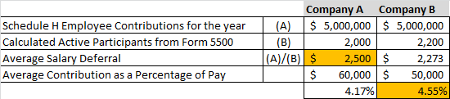
True or False:
You can accurately benchmark using 5500 Data
Question:
Plan A Average Salary Deferral = $2,500
Plan B Average Salary Deferral = $2,273
Which plan actually has better Salary Deferrals?
Plan A
Plan B
I Don’t Know
This technique of normalization is critical for accurate comparisons and this is why the 401(k) discrimination test is performed as a percentage of compensation.

Slide 13








v1 Holdover:
Use Data That Allows Valid Comparisons
100% of data should come directly from the source: Service Providers
All data is thus current, accurate and consistent with 408(b)(2) disclosures.

Slide 14
The RIGHT Way to Benchmark (U.S. Patent 8,150,198)
Use Data that has Integrity:
  Right Source
  Accurate
  Timely
  Comprehensive
Employ a Method that is Fair and Independent:
  Build an “Apples to Apples” Comparison Group
  Collect and Normalize ALL Fees
  Examine Value for Participants, Sponsors & Providers
Provide Output that is Simple, Transparent & Practical:
  Concise
  Actionable
  Timely
  Procedurally Prudent
Notes:
13

Slide 15
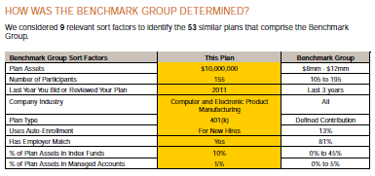
True or False:
Average Balance impacts the Benchmark Group

Slide 16
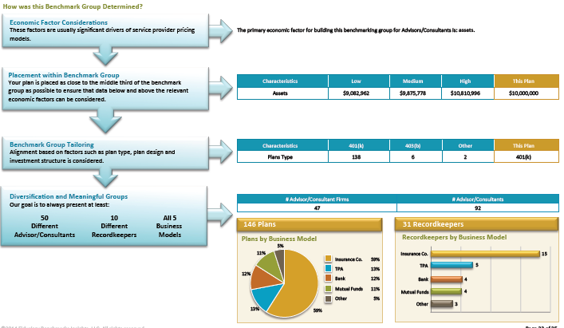
v2 Improvement:
Benchmark Groups Customized BY PROVIDER

Slide 17
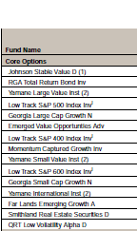
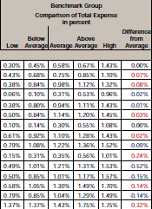
True or False:
Plans with Identical Funds Have Identical Fees

Slide 18
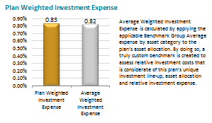
v2 Improvement:
Plan Weighted Investment Expense

Slide 19
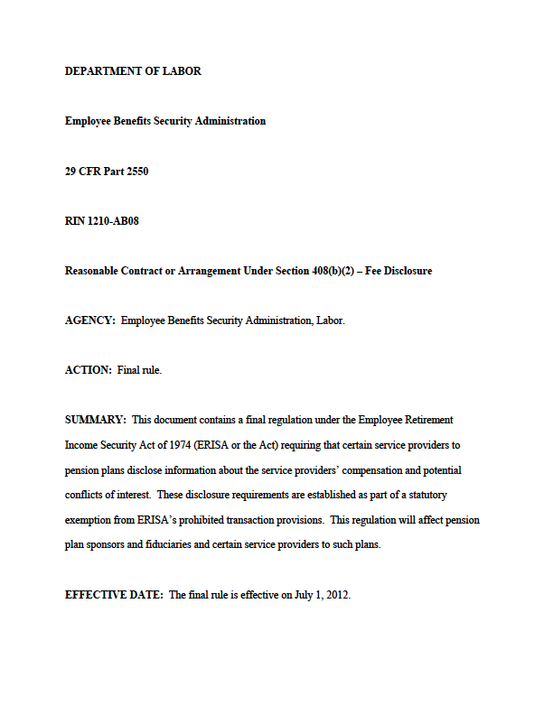
True or False:
General Accounts have No Fees

Slide 20
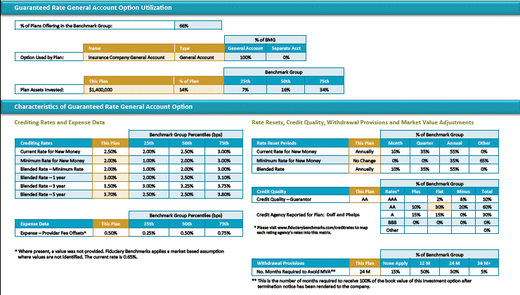
v2 Improvement:
Detail on General Accounts (and Stable Value)

Slide 21
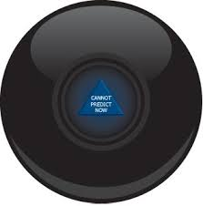
True or False:
You Can’t Predict Fees

Slide 22
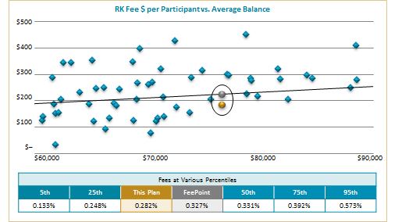
v2 Improvement:
Regression Analysis on Fees

Slide 23
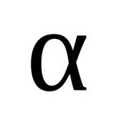

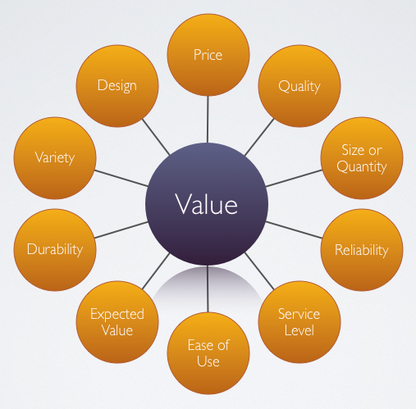
v2 Improvement:
Greater Emphasis on Fees AND Value
Investment Mgrs
RKs and TPAs
Advisors
Alpha
Beta
Plan Complexity
Recordkeeping
Administration
Compliance
Communications
Participant Success
Investments
Vendor Mgmt
Plan Mgmt
Participant Svcs
Notes:
Having the right data is only the first part of this process. You also have to use the right methodology, and that consists of three “m” words: metrics, math and meaning.
First, the methodology has to make sure it includes all relevant metrics. For example, our service measures
- Total Plan Fees
- Fees by Service Provider
Fees by Investment Option
Other important fees for things like Self-Directed Brokerage and Managed Account Programs

Slide 24
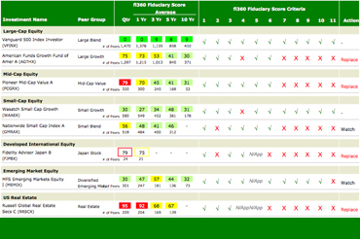
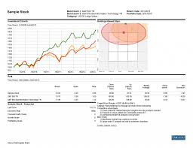
True or False:
Performance Reviews are a commodity
Notes:
Having the right data is only the first part of this process. You also have to use the right methodology, and that consists of three “m” words: metrics, math and meaning.
First, the methodology has to make sure it includes all relevant metrics. For example, our service measures
- Total Plan Fees
- Fees by Service Provider
Fees by Investment Option
Other important fees for things like Self-Directed Brokerage and Managed Account Programs

Slide 25
v2 Improvement:
Degree of Difficulty for Services
Provide and Review Performance Reporting
LESS WORK
MORE WORK
Review RK/TPA-Provided Performance Reports | Use Standardized Screening Tool (i.e. Morningstar, Lipper, etc.) | Use Customized Version of Standard Reporting Tool (i.e. Customized Morningstar, Lipper, etc.) | Create Fully-Customized Reporting Using a Tool Like MPI | Utilize Proprietary Service to Generate Custom Reporting (i.e. RPAG) | Use Fully-Customized Reporting and Have Shared Investment Staff (CFA, CIMA) Performing Analysis | Use Fully-Customized Reporting and Have Dedicated Investment Staff (CFA, CIMA) Performing Analysis
Notes:
Having the right data is only the first part of this process. You also have to use the right methodology, and that consists of three “m” words: metrics, math and meaning.
First, the methodology has to make sure it includes all relevant metrics. For example, our service measures
- Total Plan Fees
- Fees by Service Provider
Fees by Investment Option
Other important fees for things like Self-Directed Brokerage and Managed Account Programs

Slide 26

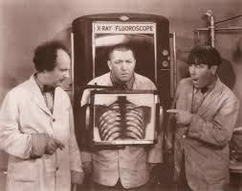
True or False:
The DOL allows you to consider Quality of a Provider
Notes:
Having the right data is only the first part of this process. You also have to use the right methodology, and that consists of three “m” words: metrics, math and meaning.
First, the methodology has to make sure it includes all relevant metrics. For example, our service measures
- Total Plan Fees
- Fees by Service Provider
Fees by Investment Option
Other important fees for things like Self-Directed Brokerage and Managed Account Programs

Slide 27
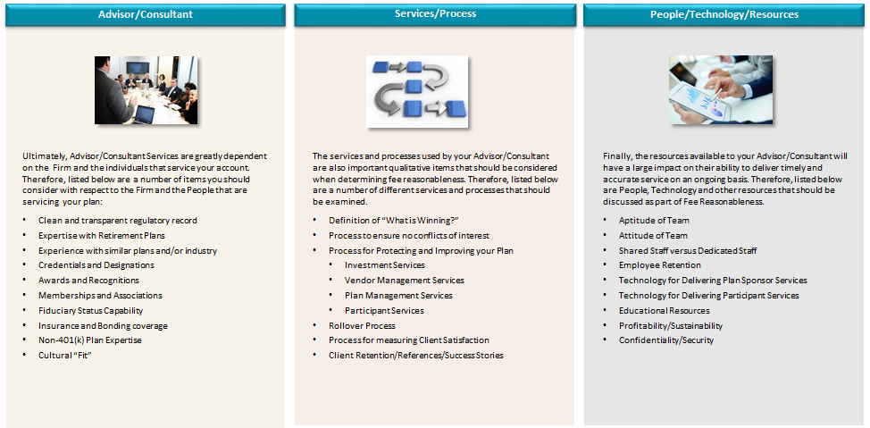
v2 Improvement:
Background of Service Provider
Notes:
Having the right data is only the first part of this process. You also have to use the right methodology, and that consists of three “m” words: metrics, math and meaning.
First, the methodology has to make sure it includes all relevant metrics. For example, our service measures
- Total Plan Fees
- Fees by Service Provider
Fees by Investment Option
Other important fees for things like Self-Directed Brokerage and Managed Account Programs

Slide 28
The RIGHT Way to Benchmark (U.S. Patent 8,150,198)
Use Data that has Integrity:
  Right Source
  Accurate
  Timely
  Comprehensive
Employ a Method that is Fair and Independent:
  Build an “Apples to Apples” Comparison Group
  Collect and Normalize ALL Fees
  Examine Value for Participants, Sponsors & Providers
Provide Output that is Simple, Transparent & Practical:
  Concise
  Actionable
  Timely
  Procedurally Prudent
Notes:
27

Slide 29
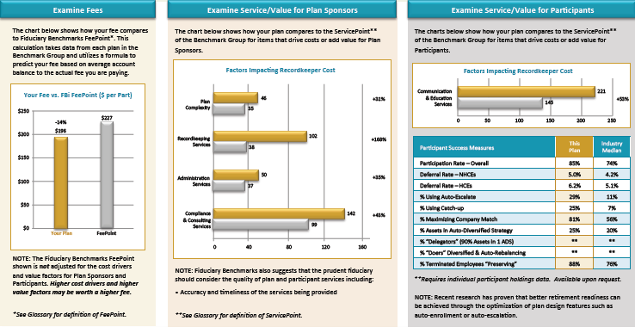
v2 Improvement:
Fees and Value for a Provider on 1 page

Slide 30
v2 Benchmarking
Helping a Plan Sponsor Protect Themselves
Make sure the service is Independent, Comprehensive and Informative
Benchmark Fees AND Cost-Driver/Value-Factors/Quality of the Provider
Are they using the right data to benchmark?
Have they considered Fees from the Insurance Company General Account?
Have they considered differences in Asset Allocation?
Are they considering the Value provided by ALL of your Service Providers?
Are they providing you information on Plan Complexity and Administrative Difficulty?
Are they providing information on helping your participants prepare for Retirement?
Are they doing all of this PROACTIVELY?
Notes:
29

Slide 31
Agenda
FBi Benchmarking Basics
Benefits to Plan Sponsors
Benefits to Participants
Notes:
30

Slide 32

Why Women Live Longer Than Men
6th Place
Notes:
31
How to implement benchmarking to drive more business
-focus conversation on….these are the things that drive your value, that you should be talking to clients about

Slide 33
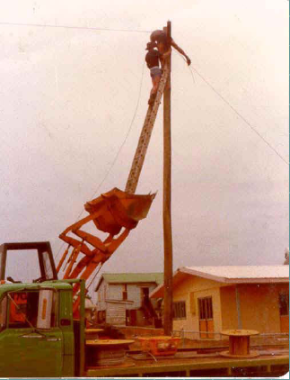
Why Women Live Longer Than Men
5th Place
Notes:
32
How to implement benchmarking to drive more business
-focus conversation on….these are the things that drive your value, that you should be talking to clients about

Slide 34

Why Women Live Longer Than Men
4th Place
Notes:
33
How to implement benchmarking to drive more business
-focus conversation on….these are the things that drive your value, that you should be talking to clients about

Slide 35
Why Women Live Longer Than Men
3rd Place
Notes:
34
How to implement benchmarking to drive more business
-focus conversation on….these are the things that drive your value, that you should be talking to clients about

Slide 36

Why Women Live Longer Than Men
2nd Place
Notes:
35
How to implement benchmarking to drive more business
-focus conversation on….these are the things that drive your value, that you should be talking to clients about

Slide 37
Why Women Live Longer Than Men
1st Place
Notes:
36
How to implement benchmarking to drive more business
-focus conversation on….these are the things that drive your value, that you should be talking to clients about

Slide 38
Why Women Live Longer Than Men
Runner-Up
Notes:
37
How to implement benchmarking to drive more business
-focus conversation on….these are the things that drive your value, that you should be talking to clients about

Slide 39
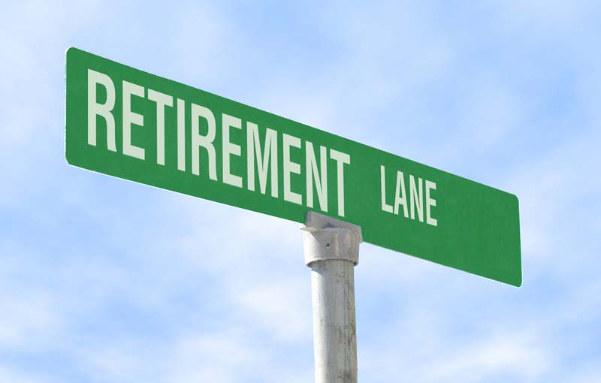




Generating Retirement Readiness
  Participation Rate: Overall, HCE and NHCE
  Deferral Rate: Overall, HCE and NHCE
  Percent Maximizing Company Match
  Percent on an Auto-Escalate Program
  Percent utilizing Catch-up
SAVING
Success Measures that have a proven impact on increasing Retirement Readiness
  Percent of Assets in Auto-Diversified Options
  Percent of Delegators with 90% in 1 ADO
  Percent of Delegators Auto-Rebalancing
  Percent NOT “cashing-out”
SPENDING
KNOWING
  Having a personal Retirement Goal
  On track to achieve that Goal
Notes:
38
How to implement benchmarking to drive more business
-focus conversation on….these are the things that drive your value, that you should be talking to clients about

Slide 40
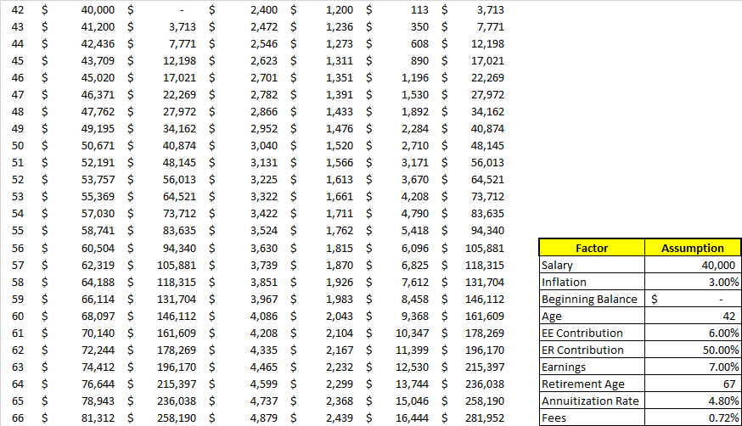
What If Analysis:
Notes:
39

Slide 41
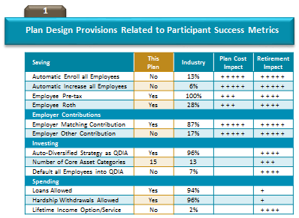
v2 Improvement:
Closer Link of Plan Design to Retirement Readiness
Notes:
Having the right data is only the first part of this process. You also have to use the right methodology, and that consists of three “m” words: metrics, math and meaning.
First, the methodology has to make sure it includes all relevant metrics. For example, our service measures
- Total Plan Fees
- Fees by Service Provider
Fees by Investment Option
Other important fees for things like Self-Directed Brokerage and Managed Account Programs

Slide 42
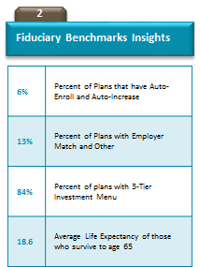
v2 Improvement:
Closer Link of Plan Design to Retirement Readiness
Notes:
Having the right data is only the first part of this process. You also have to use the right methodology, and that consists of three “m” words: metrics, math and meaning.
First, the methodology has to make sure it includes all relevant metrics. For example, our service measures
- Total Plan Fees
- Fees by Service Provider
Fees by Investment Option
Other important fees for things like Self-Directed Brokerage and Managed Account Programs

Slide 43
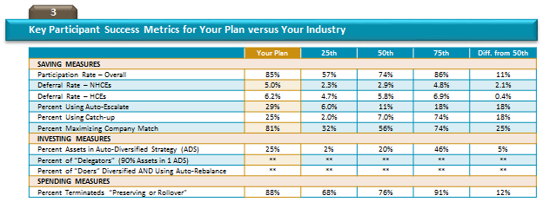
v2 Improvement:
Closer Link of Plan Design to Retirement Readiness
Notes:
Having the right data is only the first part of this process. You also have to use the right methodology, and that consists of three “m” words: metrics, math and meaning.
First, the methodology has to make sure it includes all relevant metrics. For example, our service measures
- Total Plan Fees
- Fees by Service Provider
Fees by Investment Option
Other important fees for things like Self-Directed Brokerage and Managed Account Programs

Slide 44
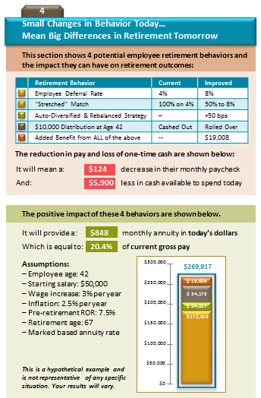
v2 Improvement:
Closer Link of Plan Design to Retirement Readiness
Notes:
Having the right data is only the first part of this process. You also have to use the right methodology, and that consists of three “m” words: metrics, math and meaning.
First, the methodology has to make sure it includes all relevant metrics. For example, our service measures
- Total Plan Fees
- Fees by Service Provider
Fees by Investment Option
Other important fees for things like Self-Directed Brokerage and Managed Account Programs

Slide 45




v2 Improvement:
Much Greater Emphasis on Value Components
Cost Drivers
Fees
Versus
Value Factors
Quality of Provider

Slide 46

This material has been prepared solely for informational and educational purposes. It is not intended to provide, and should not be relied upon for, investment, accounting, legal or tax advice.
www.fiduciarybenchmarks.com
5335 Meadows Road, Suite 210 ⎮ Lake Oswego, OR 97035 ⎮ 866.516.4909
Notes:
45

